Slide 1

TRIP REPORT
HDF and HDF-EOS Workshop XI
November 6 – 8, 2007
Raytheon Information Solutions Facility
Upper Marlboro, MD
John P. Wilson
Creare Inc.

Slide 2
Contents
Workshop Overview
Takeaways
HDF Overview
HDF Pros/Cons
Hot Topic: HDF5 v1.8.0-beta
Hot Topic: NetCDF4/HDF5 Synchronization
HDF Tools
Long-Term Archiving of NASA HDF-EOS and HDF Data
HDF in Research
HDF and Web services
HDF-RBNB Demonstration
Next Steps

Slide 3
Workshop Overview
November 6 – 8, 2007
Raytheon Information Solutions Facility, Upper Marlboro, MD
<http://www.hdfeos.org/workshops/ws11/agenda.php>
Hosted by:
  NASA, specifically NASA-EOS, <http://www.hdfeos.org/>
  The HDF Group (THG), <http://www.hdfgroup.org/>
  NOAA NPOESS (National Polar-orbiting Operational Environmental Satellite System), <http://npoess.noaa.gov/>
Theme: “Connections: Bringing together data users, providers, developers, and stewards”
  “…to encourage collaboration among communities who are making, using, providing services for, and maintaining access to data that has been flowing from existing satellites, and will begin flowing from missions in the near future”
Approximately 70 attendees from government, academia, and industry
Half of the presentations were made by THG

Slide 4
Takeaways
HDF is an impressive format with a long history of government and private use
  NASA-EOS and NPOESS
  MATLAB® and IDL
Good choice for long-term storage of large data sets
The HDF Group develops, maintains, supports, and promotes the use of HDF
  Started at NCSA and the University of Illinois in 1987
  Independent not-for-profit corporation since mid-2006
  “The mission of The HDF Group is to ensure long-term accessibility of HDF data through sustainable development and support of HDF technologies”
Hot topics: HDF5 v1.8.0 and netCDF4-HDF5 synchronization
Warrants investigation of RBNB-HDF interface

Slide 5
HDF Overview
HDF = Hierarchical Data Format
  file format for storing any type of data
  software for reading/writing the data
Objects in an HDF file:
  Groups: organize the data in a hierarchical fashion; identified by a pathname
  Datasets: data + metadata
    Attributes: optional user-defined key/value pairs
    Dataspace: the size of the data - includes rank (# dimensions) and length of each dimension
    Datatype: how to interpret the data (example: 8-byte floating point, big-endian)
    Property List: define how data is organized
      is data contiguous or chunked?, compressed?, can the dataset be extended?
Datatypes
  Atomic
    float, integer, fixed and variable length strings
    “references”: links that point to objects (groups, dataset, etc) or dataset regions in the HDF file
  Compound
    “Tables” - user-defined, like C-structures; can contain atomic or other compound types
Virtual File I/O
  write to file or group of files, network, memory
  parallel I/O (if supported by the platform)
  Support for user-defined I/O (write to user-defined device)
High level API available for ease of use

Slide 6
HDF Overview (Cont’d)
Partial I/O: read/write only a portion of a dataset
  ex: read part of an image from file
  hyperslab selection: one or more contiguous sections of memory at regular or irregular intervals
  point selection: one or more individual points
Chunking: break data down into small, fixed-size chunks, required when:
  Extending datasets
  Using compression or filters
  To improve partial I/O in large datasets
Filters, automatically applied during I/O
  Checksum
  Shuffling filter (change byte order in a data stream)
    used with compression to increase compression ratio by taking out unnecessary “0” bytes
  Compression
    Scale+offset: lossy compression; store integers instead of floats
    N-bit: specify how many bits make up a data value
    GZIP, SZIP
  User can develop custom filters
Support for large data sets
  No theoretical limit on size (limits imposed by the platform)
  Chunking, compression, caching, partial I/O mitigate problems working with large data sets
  HDF5 has been used to support terabyte-sized datasets/files (<http://hdfgroup.org/why_hdf/#large>)
HDF5 proposed to ISO as a binary data format for CAD/CAM

Slide 7
HDF Pros
Free, open source, cross platform
Well established standard with a long history
Support from The HDF Group
C, C++, Fortran 90, and Java bindings
Define hierarchical structure and user-defined attributes
Store metadata with the data
Support for data conversion, filters, compression
Efficient I/O (partial I/O; caching; parallel I/O)
Supporting tools from THG, government, and third-party
Optimized for large data sets
Synchronization between netCDF4 and HDF5 v1.8.0
Support for both atomic and compound data types

Slide 8
HDF Cons
Learning curve
Choices – could be a pro or con
  Multiple HDF libraries (high and low level)
  Multiple APIs/formats: HDF, netCDF, EOS, NPOESS
  Multiple versions: HDF4, HDF5 v1.6, HDF5 v1.8
No streaming support
Considering RBNB integration as archive format
  Depending on a third-party
  Require commitment to a more recent version of Java

Slide 9
Hot Topic: HDF5 v1.8.0-beta
<http://www.hdfgroup.uiuc.edu/HDF5/doc_1.8pre/WhatsNew180.html>
Major update: new capabilities, improved performance, retain compatibility
Improved metadata caching, smaller memory footprint
New filters (scale+offset, n-bit)
Dimension scales
  associate an array with one or more other arrays
  ex: associate an array containing times with one or more sensor data value arrays
Support for iterating over objects (groups, datasets, etc) by their creation order
UTF-8 Unicode encoding of strings
Can link/reference objects in another HDF file
Create intermediate groups
  automatically create group “folders” that don’t yet exist
  ex: if ask for “a/b/c” and “a” and “b” don’t exist, they will be created
Copy objects from one HDF5 file to the same or a different HDF5 file
Arithmetic Data Transform on I/O: perform arithmetic operations during file I/O

Slide 10
Hot Topic: NetCDF4/HDF5 Synchronization
<http://www.unidata.ucar.edu/software/netcdf/netcdf-4/>
Joint project between NCSA, THG, and Unidata
netCDF4 uses HDF5 v1.8.0 as its storage layer
netCDF4 library allows the user to read/write HDF5 files
Both netCDF4 and HDF5 v1.8.0 still in beta
Combine strengths of both libraries
  netCDF: popular format, simple to use
  HDF5: very general, high performance
New netCDF4 features (to bring it in line with HDF5)
  Compound and variable length datatypes
  Groups (data hierarchy)
  Multiple unlimited dimensions (for extending datasets)
  Compression (only deflate currently supported)
  Parallel I/O
Limitations
  netCDF4 can’t read all HDF5 files
    No scale+offset, N-bit, or SZIP compression
    No user-defined filters
    Only uses chunking storage
    Can only read HDF5 files which use dimensional scales
  No Fortran90 API
  No Windows platform support (only Cygwin on Windows)
HDF5 files written by netCDF4 can always be read using the HDF5 library

Slide 11
HDF Tools from THG (<http://hdfgroup.org/products/hdf5_tools/>)
Readers
h5dump – Dump file content as ASCII text, XML, or binary
h5diff - Compares two HDF5 files and reports the differences
h5ls - Lists selected information about file objects in the specified format
HDFView – A Java-based tool for browsing and editing HDF4 and HDF5 files
New tools
  h5check – checks if an HDF5 file is encoded according to the HDF5 File Format Specification
  h5stat – print statistics about an HDF5 file
Writers
h5repack - Copies an HDF5 file to a new file with or without compression/chunking
h5repart - Repartitions a file into a family of files
h5import - Imports ASCII or binary data into HDF5
h5jam/h5unjam - Add/Remove text to/from User Block at the beginning of an HDF5 file
HDFView – A Java-based tool for browsing and editing HDF4 and HDF5 files
New tools
  h5copy – copy an object to the same HDF5 file or to a different HDF5 file
  h5mkgrp - create a new group in an HDF5 file
Converters
h5toh4 – convert HDF5 file to an HDF4 file
h4toh5 – convert HDF4 file to an HDF5 file
gif2h5 - Converts a GIF file into HDF5
h52gif - Converts an HDF5 file into GIF
Other
h5cc, h5fc, h5c++ - Simplifies compiling an HDF5 application
h5redeploy - Updates HDF5 compiler tools' paths after the HDF5 software has been installed in a new location
h5debug - Debugs an existing HDF5 file at a low level
h5pef_serial – serial I/O benchmarking tool

Slide 12
HDF and HDF-EOS Tools From NASA
<http://www.hdfeos.org/workshops/ws11/presentations/day2/HDF_WK_poster.ppt>
Data Handling Tools
READ_HDF (GES DISC)
Hdfscan (LaRC ASDC)
IDL Data Analysis
misr_view (LaRC ASDC)
view_hdf (LaRC ASDC)
Subsetting Tools
HE5Subset (GES DISC)
HDF-EOS Subsetter (GHRC)
SPOT (GHRC)
Reprojection Tools
MRT (LP DAAC)
MRTSwath (LP DAAC)
MS2GT (NSIDC DAAC)

Slide 13
Third-Party Tools with HDF Interfaces
Many tools listed at <http://hdf.ncsa.uiuc.edu/tools5desc.html>
Tools discussed at the workshop:
Grid Analysis and Display System (GrADS)
  <http://www.iges.org/grads/>
  Access, analyze, and display earth science data
  Support for netCDF and HDF4; planning for HDF5
  OPeNDAP enabled
HDF Explorer
  <http://www.space-research.org>
  Free Windows data visualization program
  Support for HDF4, HDF5, HDF-EOS and netCDF
HDF tools from NCAR
  NCAR Command Language (NCL); <http://www.ncl.ucar.edu>
    scripting language for scientific data analysis and visualization
    Support for reading netCDF, HDF4, HDF4-EOS; writing netCDF and HDF4
  Python libraries with same basic support as NCL
    Python NCL Graphics Library (PyNGL); <http://www.pyngl.ucar.edu>
    Python NCL I/O Library (PyNIO); <http://www.pyngl.ucar.edu/Nio.shtml>

Slide 14
Third-Party Tools, continued
MATLAB®
  <http://www.mathworks.com/>
  Support for HDF4, HDF-EOS2, and HDF5
  Both a high level API as well as an API very close to the “C” API
  Internally uses HDF5: data stored in HDF5 format when file is larger than 2GB
ENVI/IDL
  IDL includes an API for reading/writing HDF files
  ENVI (<https://www.ittvis.com/envi/>)
    built on top of IDL
    remote sensing image processing (feature extraction, spectral analysis, etc)
  ENVIZoom (<https://www.ittvis.com/envi/zoom/index.asp>)
    Includes support for accessing data via OGC WMS (Web Mapping Service – get images) and OGC WCS (Web Coverage Service – get data)
PyTables
  <http://www.pytables.org>
  Used to manage large hierarchical datasets
  built in Python on top of HDF5 library

Slide 15
Long-Term Archiving of NASA HDF-EOS and HDF Data
Presentation by Ruth Duerr, National Snow and Ice Data Center
Problem
  Majority of EOS data is stored in HDF4 or HDF-EOS2 format
  How to read these files if the HDF APIs are no longer available?
Solution
  Create XML document (“map”) to describe content of an HDF file
  Develop tools that don’t depend on HDF API for reading the “map” and then access data in the associated HDF file
  They are assessing and categorizing all NASA HDF4 data as part of this project
Submitting a paper to the special issue of IEEE Transactions of Geoscience and Remote Sensing devoted to Data Archiving and Distribution

Slide 16
HDF in Research
NASA EOS, “the 800 pound gorilla” in the HDF community
NPP/NPOESS
Lightning research at MSFC
  <http://thunder.msfc.nasa.gov/>
  LIS and OTD lightning data and other large sets are in HDF4 format
  HDF interface developed by John Hall using the C language binding
EUMETNET: “The Network of European Meteorological Services”
  <http://www.eumetnet.eu.org/>
  “OPERA” report in 2006 evaluated data formats
    recommends HDF5 as an official European standard for weather radar data and products
    due to efficiency of the compression algorithm (ZLIB) and platform independence
European Space Agency (<http://earth.esa.int/>)
Environmental Modeling Research Laboratory (ERML) at Brigham Young University
  Create ground water, watershed, and surface water models
  Developed Generic Model Data Format (XMDF), “a C and Fortran language library providing a standard format for the geometry data storage of river cross-sections, 2D/3D structured grids, 2D/3D unstructured meshes, geometric paths through space, and associated time data.”
  XMDF is based on HDF5
  <http://emrl.byu.edu/xmdf1/index.html>
  They evaluated netCDF and HDF5
    both had similar stability, support, and performance
    chose HDF5: more flexibility for data storage, compression, and data mining
Notes:
During the conference, one presenter mentioned that ¼ of all NASA data is in HDF format (NASA-EOS or plain vanilla HDF)
In Ruth Duerr’s presentation, she mentioned that there is roughly a 50/50 split in NASA data stored in HDF-EOS format and plain HDF format

Slide 17
NASA EOS
HDF-EOS is NASA’s primary format for EOS instrument data products
  A layer on top of HDF: adds geolocation, conventions, and data types to HDF in order to standardize storage of and access to common earth science data structures
  Data types
    Swath: Data array organized by time (or other track parameter); includes geolocation information
    Grid: Data organized by regular geographic spacing in a specified mapping projection
    Point: temporal or spatial data but with no particular organization; data organized in tables
    Zonal Average (ZA): similar to swath, but without geolocation data; for HDF-EOS5 only
  HDF-EOS2 based on HDF4; used by MODIS, MISR, ASTER, Landsat, AIRS, and others
  HDF-EOS5 based on HDF5: used by Aura instruments
  Specific attributes from HDF-EOS file are extracted/stored in searchable database tables
NASA Earth Science Data and Information System (ESDIS) manages the Earth Observing System Data and Information System (EOSDIS)
  See <http://spsosun.gsfc.nasa.gov/eosinfo/Welcome/>
EOSDIS Core System (ECS): client-server architecture for accessing HDF-EOS data from NASA Distributed Active Archive Centers (DAACs) and other sources
  See <http://observer.gsfc.nasa.gov/> and <http://observer.gsfc.nasa.gov/sec2/architecture/architecture.html>
Cumulative data archive managed by ESDIS is about 5,000TB
ESDIS distributes about 120TB of data per month
Web data access
  EOS Data Gateway: <http://redhook.gsfc.nasa.gov/~imswww/pub/imswelcome/>
  EOS Clearinghouse (ECHO): <http://www.echo.eos.nasa.gov/>
    NASA DAACs and other data providers submit their metadata to ECHO
    users submit queries and are directed where to obtain the data

Slide 18
NPP/NPOESS
DOC, DOD, NASA project managed by NOAA Integrated Program Office
NPOESS = National Polar-orbiting Operational Environmental Satellite System
NPP = NPOESS Preparatory Program (joint NASA/IPO project)
<http://www.ipo.noaa.gov/>
Mission
  “converge existing polar-orbiting satellite systems under a single national program”
  Provide weather and climate forecast data
They have developed a standard format based on HDF5
Strengths
  Straight HDF5 format
  Provides a consistent data organization across all data products
  Flexible temporal aggregation (“granules” are appended by extending dataset)
  “nub” (NPOESS User Block) is an XML block stored in the HDF5 file
    provides an overview of the metadata in the file
    “nub tool” can read/write the XML nub
Challenges
  Geolocation data is stored in a separate group and may be in a separate file
  Field metadata (used to interpret data) is in a separate XML “profile” file
  Quality flags must be parsed before data can be interpreted
  Information needed to un-scale scaled integers is not obvious
    they use their own scale+offset compression format, not the HDF5 standard scale+offset compression
  They use HDF5 indirect reference links (to link metadata to the data): complex to use and not supported by all third-party HDF5 tools

Slide 19
HDF and Web Services
OGC Web Coverage Service Using HDF5/HDF-EOS5
Access HDF5 Datasets via OPeNDAP
Note: some HDF5 tools support XML
  <http://www.hdfgroup.org/HDF5/XML/>

Slide 20
Web Services, OGC WCS Using HDF5/HDF-EOS5
Presentation by Dr. Peichuan Li, George Mason University, Center for Spatial Information Science and Systems (CSISS)
Part of the Sensor Web project at CSISS
Web Coverage Service
  An OGC web service for retrieving geospatial data
  WCS returns data (unlike Web Map Service, which returns image)
Developed a WCS which returns data in HDF-EOS5/HDF5 format
Optional data sub-setting
  Domain sub-setting based on time
  Range sub-setting based on a non-time parameter
    Example: what is the O3 level for Pressure values x, y, and z?
Current limitations
  Specifically built/tested for Aura/HIRDSL L2 data
  Domain sub-setting using bounding box will be added later
  Output format is HDF-EOS5 and netCDF

Slide 21
Web Services, Access HDF5 Datasets via OPeNDAP
OPeNDAP = Open-source Project for a Network Data Access Protocol
  Communication protocol based on HTTP
  Widely used by earth science community
  OPeNDAP client (usually not a browser) communicates with OPeNDAP server
  Can retrieve subsets of files or aggregate data from several files in one transfer
THG project: enhance HDF5 OPeNDAP server and test with clients
  The HDF5 and EOS data structures needed to be mapped to DAP structures
  A MATLAB® client is in progress
  Other OPeNDAP clients are being tested (GrADS, Ferret, ncBrowse, others)
  Demonstrated the capability using Aura data (HDF-EOS5)

Slide 22
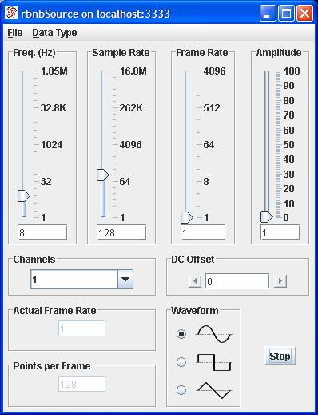



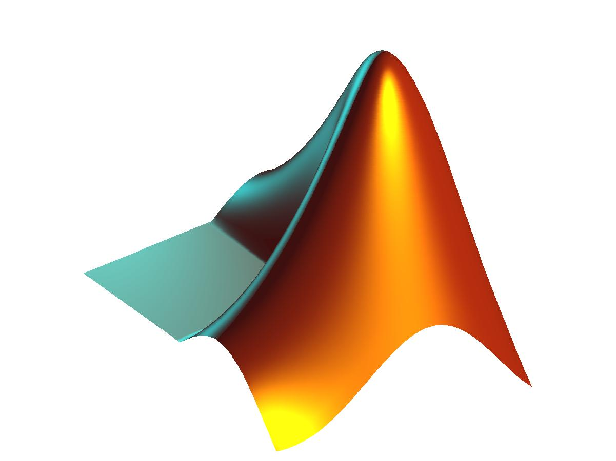
HDF-RBNB (DataTurbine) Demonstration
Save data from “rbnbSource” to HDF5 file
RBNB2HDF
h5dump
MATLAB
HDFView
“RBNBData.h5”

Slide 23
HDF-RBNB Demonstration, Programming Notes
HDF library routines begin with “H5X”, where ‘X’ indicates the type of method:
  H5F = working with a File
  H5D = working with a Dataset
  H5S = working with a DataSpace
  H5P = working with a Property List
  H5G = working with a Group
  H5A = working with an Attribute
Streaming data from RBNB ➔ HDF dataset must be extendible ➔ use data chunking

Slide 24
HDF-RBNB Demonstration, Java Code
1 import ncsa.hdf.hdf5lib.H5;
2 import ncsa.hdf.hdf5lib.HDF5Constants;
3 import com.rbnb.sapi.*;
4
5 public class RBNB2HDF {
6 private static String fname = "RBNBData.h5";
7 private static int PTS_PER_FRAME = 128;
8
9 public static void main( String args[] ) throws Exception {
10
11 ////////////////////////////////////////////
12 // Create the data space with unlimited rows
13 ////////////////////////////////////////////
14 int rank = 2;
15 long[] dims = {PTS_PER_FRAME,2}; // Initial size of dataset
16 long[] maxdims = {HDF5Constants.H5S_UNLIMITED,2}; // Unlimited number of rows
17 int dataspace = H5.H5Screate_simple (rank, dims, maxdims);
18
19 // Create a new file. If file exists its contents will be overwritten
20 int file =
21 H5.H5Fcreate(
22 fname,
23 HDF5Constants.H5F_ACC_TRUNC,
24 HDF5Constants.H5P_DEFAULT,
25 HDF5Constants.H5P_DEFAULT);
26
27 // Modify dataset creation properties to enable chunking
28 // NOTE: A dataset MUST be chunked in order to be extendible
29 int cparms = H5.H5Pcreate(HDF5Constants.H5P_DATASET_CREATE);
30 // Each chunk we write to the dataset will be PTS_PER_FRAME rows X 2 cols
31 long[] chunk_dims = {PTS_PER_FRAME,2};
32 int status = H5.H5Pset_chunk(cparms, rank, chunk_dims);

Slide 25
HDF-RBNB Demonstration, Java Code (Cont’d)
33 // Create a new dataset within the file
34 // using the cparms creation properties (created above)
35 // The dataset will be at /rbnbSource/c0
36 int groupID = H5.H5Gcreate(file, "rbnbSource", 0);
37 int dataset =
38 H5.H5Dcreate(
39 groupID,
40 "c0",
41 HDF5Constants.H5T_NATIVE_DOUBLE,
42 dataspace,
43 cparms);
44 status = H5.H5Gclose(groupID);
45
46 /////////////////////////////////
47 // Open connection to RBNB server
48 /////////////////////////////////
49 Sink mySink = new Sink();
50 mySink.OpenRBNBConnection("localhost", "mySink");
51 // Subscribe to a channel
52 ChannelMap reqmap = new ChannelMap();
53 reqmap.Add("rbnbSource/c0");
54 mySink.Subscribe(reqmap);
55 ChannelMap datamap = null;

Slide 26
HDF-RBNB Demonstration, Java Code (Cont’d)
56 ///////////////////////////////////////////
57 // Fetch data and append it to the data set
58 ///////////////////////////////////////////
59 int nextRow = 0;
60 int loopCount = 0;
61 while (loopCount < 20) {
62 // Give up to 10 seconds to fetch next data frame
63 datamap = mySink.Fetch(10000);
64 double[] times = datamap.GetTimes(0);
65 float[] data = datamap.GetDataAsFloat32(0);
66 // set the data values
67 double[][] data2D = new double[PTS_PER_FRAME][];
68 for (int i=0; i<PTS_PER_FRAME; ++i) {
69 data2D[i] = new double[2];
70 data2D[i][0] = times[i];
71 data2D[i][1] = (double)data[i];
72 }
73
74 // Extend the dataset - specify the new number of rows and cols
75 long[] size = new long[2];
76 size[0] = nextRow + PTS_PER_FRAME;
77 size[1] = 2;
78 status = H5.H5Dextend (dataset, size);

Slide 27
HDF-RBNB Demonstration, Java Code (Cont’d)
79 // Select a hyperslab
80 int filespace = H5.H5Dget_space(dataset);
81 long[] offset = new long[2];
82 offset[0] = nextRow;
83 offset[1] = 0;
84 status =
85 H5.H5Sselect_hyperslab(
86 filespace,
87 HDF5Constants.H5S_SELECT_SET,
88 offset,
89 null,
90 chunk_dims,
91 null);
92
93 if (loopCount > 0) {
94 // Define memory space
95 // NOTE: We don't do this on the first loop iteration
96 // because the dataset already had initial memory
97 // allocated.
98 dataspace = H5.H5Screate_simple(rank, chunk_dims, null);
99 }

Slide 28
HDF-RBNB Demonstration, Java Code (Cont’d)
100 // Write the data to the hyperslab
101 status =
102 H5.H5Dwrite(
103 dataset,
104 HDF5Constants.H5T_NATIVE_DOUBLE,
105 dataspace,
106 filespace,
107 HDF5Constants.H5P_DEFAULT,
108 data2D);
109
110 nextRow += PTS_PER_FRAME;
111 ++loopCount;
112
113 status = H5.H5Sclose (filespace);
114 } // end while loop
115
116 // Close resources
117 status = H5.H5Dclose (dataset);
118 status = H5.H5Sclose (dataspace);
119 status = H5.H5Fclose (file);
120
121 } // end main

Slide 29
HDF-RBNB Demonstration, Java Code Notes
Peter Cao at THG leads HDF-Java development; xcao@hdfgroup.org
Intermediate buffering of RBNB data would improve efficiency
  don’t extend HDF dataset for each RBNB fetch
RBNB2HDF is a Java translation of THG “c-extend.c” example
Uses HDF JNI interface, not higher-level Java object interface
Since data is saved to HDF as a 2D array, all elements must be homogeneous (thus, float data is cast to double to match the double timestamps)
  Could define a compound data type (a table) to save different types of data together (float, double, int, etc).

Slide 30
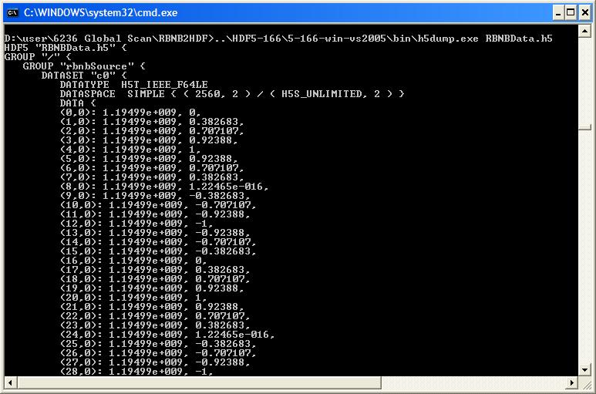
HDF-RBNB Demonstration, h5dump
Used to display, subset, and save data from an HDF5 file

Slide 31
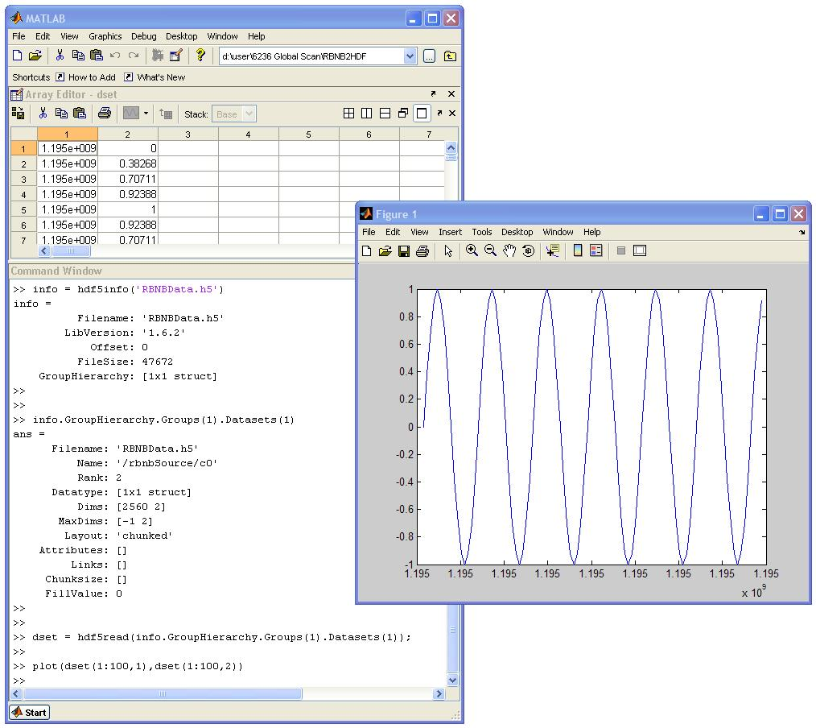
HDF-RBNB Demonstration, MATLAB®
Supports HDF4, HDF5, and HDF-EOS
HDF Import Tool (“hdftool”) for working with HDF4 and
HDF-EOS files
Both high- and
low-level APIs
  Example
    hdf5read()
    H5F.open()

Slide 32
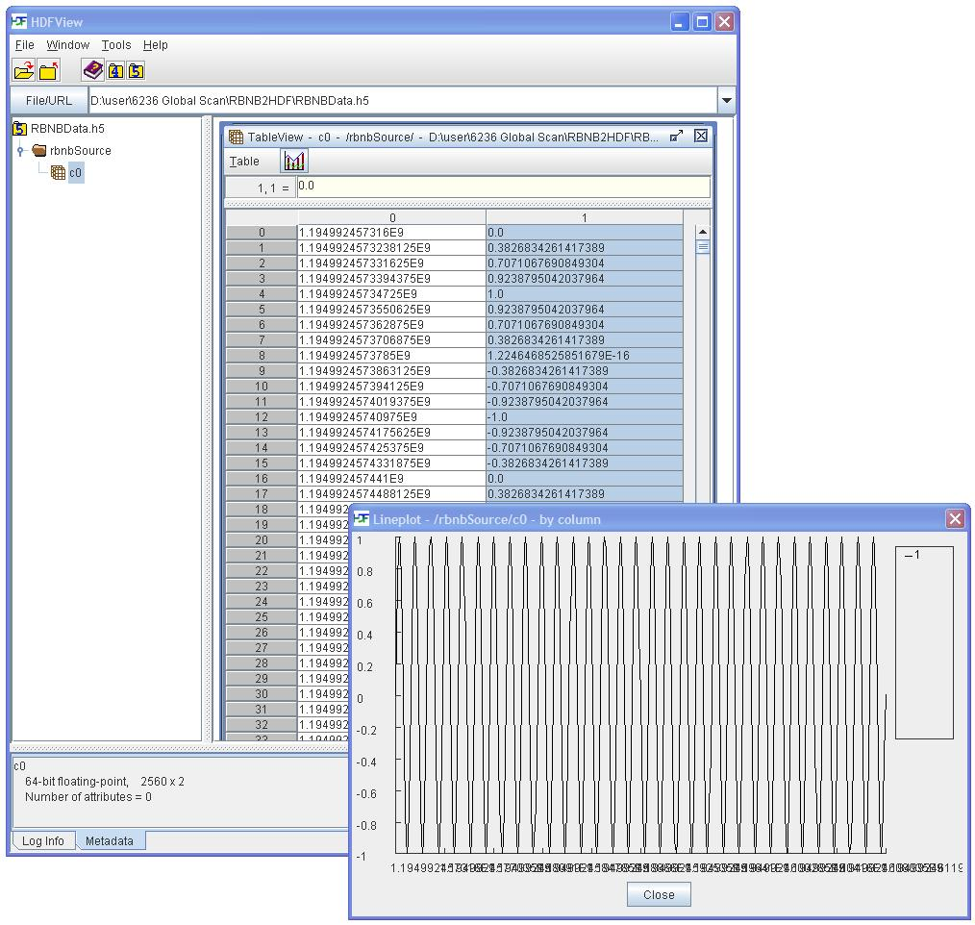
HDF-RBNB Demonstration, HDFView
Java GUI for viewing and editing content of HDF4 and HDF5 files

Slide 33
Next Steps
Investigate RBNB-HDF5 interface
  Develop RBNB PlugIn for reading/writing HDF5
  Investigate HDF5 as an RBNB archive format
Investigate RBNB support for other data file formats
  Larry Freudinger: NASA DFRC flight data archived in "cmp4" time history format; can data be read through RBNB with enough performance for realtime playback?
Other file formats to archive RBNB data or (gasp!) replace RBNB?
  Paul Hubbard at SDSC wonders if “HDB” could be used for RBNB archiving (<http://www.hampusdb.org/>)
  Matt Miller at Erigo: “The hybrid cache/archive system in the current RBNB is for performance, but the paradigm would be simpler/cleaner if there was a single consistent data storage approach.”
Catalog sources of HDF data for RTMM “mash-ups”
  Check with Ruth Duerr at National Snow and Ice Data Center
Develop PlugIn to wrap RBNB as an OPeNDAP client
How can RBNB work with OGC WCS or WMS to serve data?

